Slide 1


Pablo Andres Velasquez Barillas
June 8, 2022

Slide 2

Outline
Executive Summary
Introduction
Methodology
Results
Conclusion
Appendix

Slide 3
Executive Summary
Summary of methodologies
Data Collection API
Data Collection Web Scraping
Data Wrangling
Exploratory Data Analysis SQL
Exploratory Data Analysis Data Visualization
Data Visualization With Folium
Machine Learning Prediction
Summary of all results
Data Analysis Result
Visualize the data
Predictive Analytics

Slide 4
Introduction
Project background and context
Space X advertises Falcon 9 rocket launches on its website with a cost of 62 million dollars; other providers cost upward of 165 million dollars each, much of the savings is because Space X can reuse the first stage. Therefore, if we can determine if the first stage will land, we can determine the cost of a launch. This information can be used if an alternate company wants to bid against space X for a rocket launch. Determine the price of each launch, if we can determine if the first stage will land, we can determine the cost of a launch.
Problems you want to find answers
determine if falcon 9 can land successfully.
What factors influence a landing?
successfull rate of landing

Slide 5

Section 1

Slide 6
Methodology
Executive Summary
Data collection methodology:
Data was collected using SpaceX API
and using web scraping from Wikipedia.
Perform data wrangling
Cleaning data, identify missing values, exploratory data identify categorical and numerical values.
Create one- hot encoding to categorical features.
Perform exploratory data analysis (EDA) using visualization and SQL
Perform interactive visual analytics using Folium and Plotly Dash
Perform predictive analysis using classification models
How to build, tune, evaluate classification models

Slide 7
Data Collection
Method 1 using API
Using get request to the Space X API .
Decoded the response using .json() function and transform it to pandas dataframe using .json_normalize().
Clean data, check for missing values and one- hot encoding in categorical features.
Web scrapping
Data was collected from Wikipedia for Falcon 9 using BeautifulSoup.
It was extracted as HTML and convert it to a pandas dataframe to be analyzed.

Slide 8
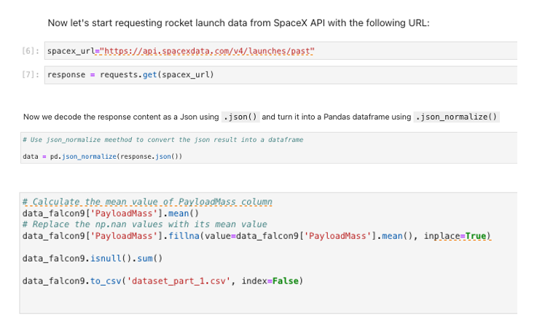
Data Collection – SpaceX API
We use get request followed by cleaning and finish creating a new data set as CSV.
Notebook link Github
https://github.com/pabvel/Coursera_Capstone/blob/main/jupyter-labs-spacex-data-collection-api(Solve).ipynb

Slide 9
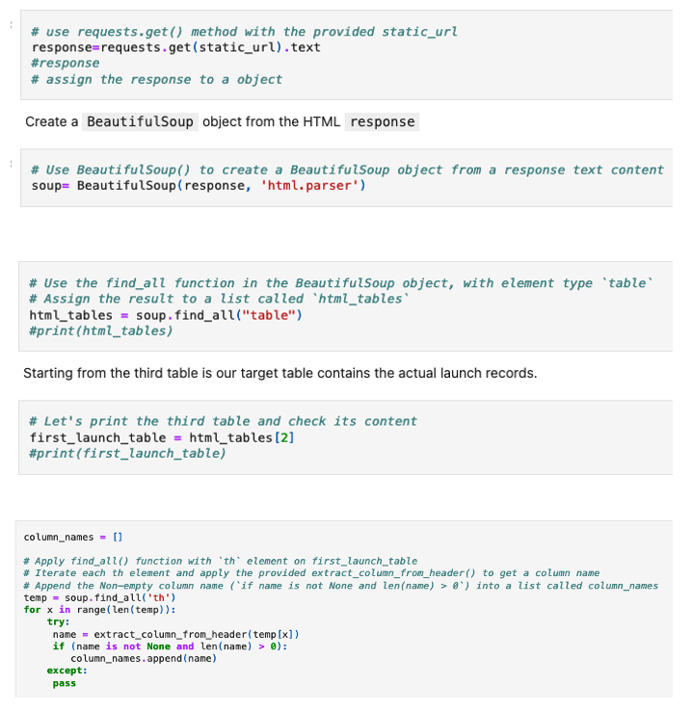
Data Collection - Scraping
Web scrapping Falcon 9 launch using BeautifulSoup, then we convert it into a dataframe using pandas.
Github
https://github.com/pabvel/Coursera_Capstone/blob/main/jupyter-labs-webscraping(Solve).ipynb
Place your flowchart of web scraping here

Slide 10
Data Wrangling
We performed a data exploratory; we fill the missing values and count the value of each site; we replace de outcome landing for dummi values and exported the results as CSV file
Github link
https://github.com/pabvel/Coursera_Capstone/blob/main/labs-jupyter-spacex-Data%20wrangling(Solve).ipynb

Slide 11
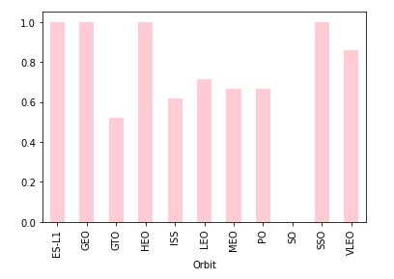
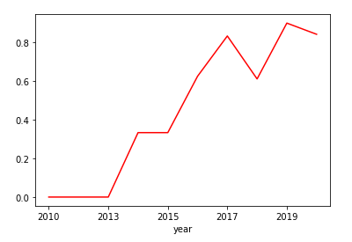
EDA with Data Visualization
We use data visualization to perform a relationship between success rate and each orbit type.
Also, a trend yearly success of launch.
GitHub URL
https://github.com/pabvel/Coursera_Capstone/blob/main/jupyter-labs-eda-dataviz(Solve).ipynb

Slide 12
EDA with SQL
Display th enames of unique launch sites in the space mission .
The total payload mass carried by boosters launched by NASA (CRS)
Average payload mass carried by booster version F9 v1.1
Total number of successful and failure mission outcomes.
The failed landing outcomes in drone ship.
GitHub URL
https://github.com/pabvel/Coursera_Capstone/blob/main/jupyter-labs-eda-sql-coursera_sqllite(Solve).ipynb

Slide 13
Build an Interactive Map with Folium
We mark all launch sites on map.
Mark the success/failed launches from each site, success =1 fail=0
Color labeled on map
Calculate distance between proximities
GitHub URL
https://github.com/pabvel/Coursera_Capstone/blob/main/lab_jupyter_launch_site_location(Solve).ipynb

Slide 14
Build a Dashboard with Plotly Dash
Create an interactive dashboard with ploty Dash
Plot a pie chart showing total launches by sites.
Create a Scatter graph showing relationship with Outcome and payload mass for each booster version.
GitHub URL
https://github.com/pabvel/Coursera_Capstone/blob/main/Dash_SpaceX.py

Slide 15
Predictive Analysis (Classification)
Using different libraries, we transformed the data, split our data into training and testing to be evaluated in different models.
We built different machine learning models and tune different hyperparameters using GridSearchCV.
We found the best performing classification model.
GitHub URL https://github.com/pabvel/Coursera_Capstone/blob/main/SpaceX_Machine%20Learning%20Prediction_Part_5(Solve).ipynb

Slide 16
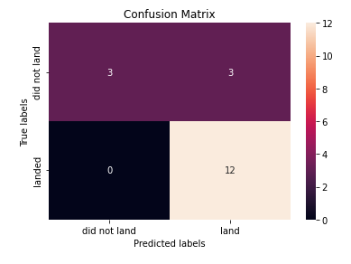
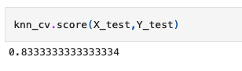
Results
Exploratory data analysis results
Interactive analytics demo in screenshots
Predictive analysis results

Slide 17

Section 2

Slide 18
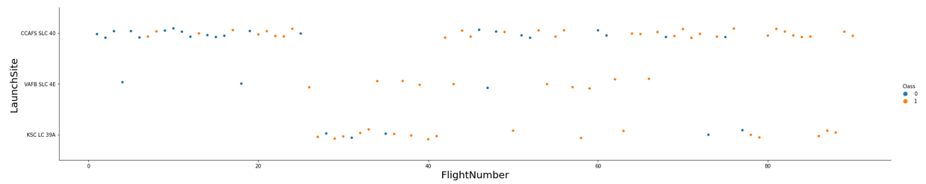
Flight Number vs. Launch Site
From the graph we can see the site with the highest rate of success in landing, with 1 being a successful landing and 0 being a failed landing.

Slide 19
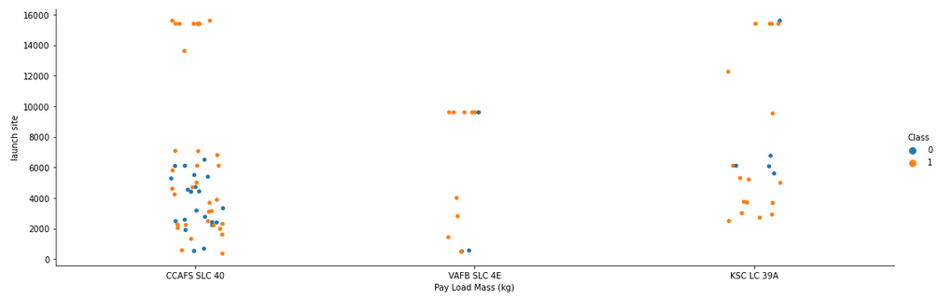
Payload vs. Launch Site
The higher the payload mass, the CCAFS SLC 40 launch site has the higher success rate.

Slide 20
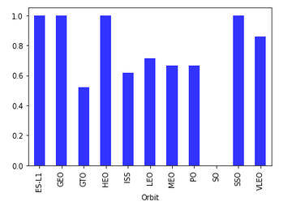
Success Rate vs. Orbit Type
we can see that ES-L1, GEO, HEO, SSO, VLEO had the most success rate.

Slide 21
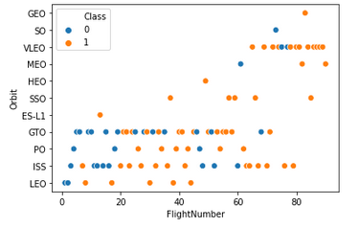
Flight Number vs. Orbit Type
the graph shows the relationship between the number of flights and the orbit, we can only observe that in the GEO orbit it has a greater success of flights.

Slide 22
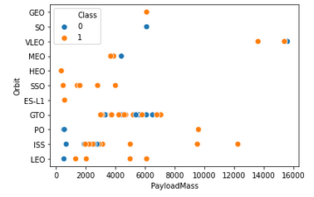
Payload vs. Orbit Type
we can see that the ISS, VLEO and PO orbits have heavy flight payloads

Slide 23
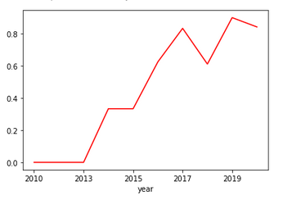
Launch Success Yearly Trend
From the graph we can observe a positive trend in the success of flights

Slide 24
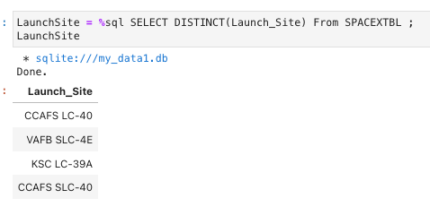
All Launch Site Names
We use DISTINCT statement to display only launch site from space X data.

Slide 25
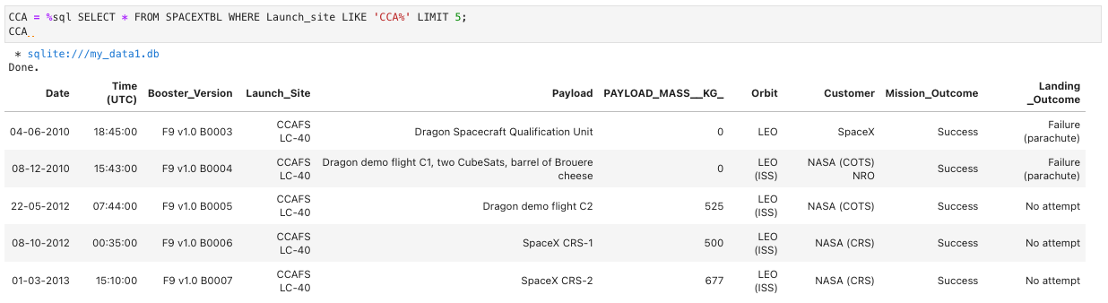
Launch Site Names Begin with 'CCA'
We find 5 records where launch sites begin with `CCA`

Slide 26
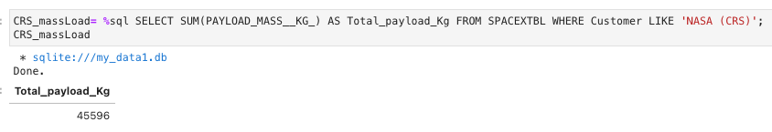
Total Payload Mass
We calculate the total payload carried by NASA's boosters to be 45,596 Kg.

Slide 27
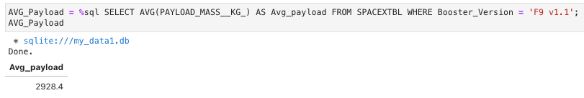
Average Payload Mass by F9 v1.1
We calculate the average payload mass carried by booster version F9 v1.1 to be 2,928.4 Kg

Slide 28
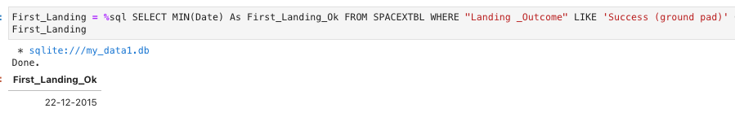
First Successful Ground Landing Date
We find the dates of the first successful landing outcome on ground pad.

Slide 29
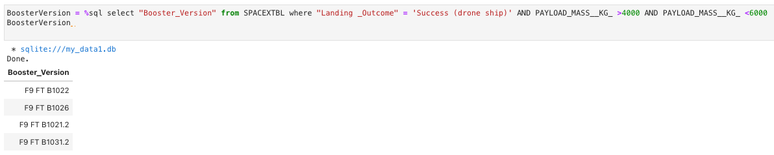
Successful Drone Ship Landing with Payload between 4000 and 6000
We use the WHERE clause as well AND to filter the drone ship but also the payload range between 4000 and 6000.

Slide 30
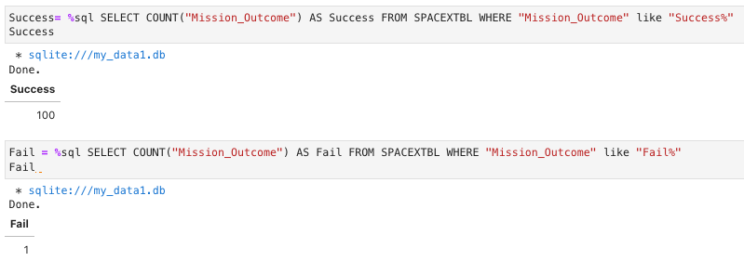
Total Number of Successful and Failure Mission Outcomes
we use wildcard like '%' in WHERE statement to filter mission_outcome was successful or failed.

Slide 31
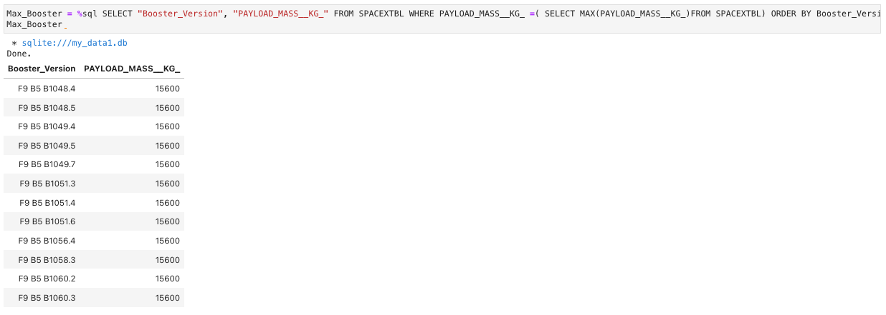
Boosters Carried Maximum Payload
In order to obtain the maximum load of each booster version, a sub-query was used in the WHERE statement in addition to the MAX() function inside the sub-query.

Slide 32
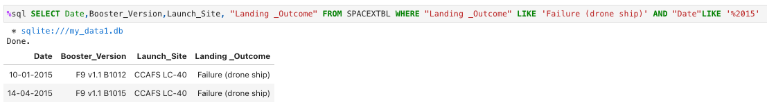
2015 Launch Records
we use a combination of functions to filter out failed bosster versions as well as landing places, functions like LIKE and AND.

Slide 33
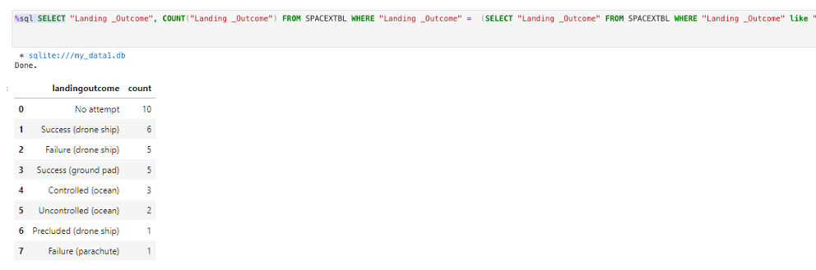
Rank Landing Outcomes Between 2010-06-04 and 2017-03-20
we use counter to count landing-outcome we use WHERE statement to filter the year conditions and we group them using GROUP BY and DESC so that it is sorted in descending order

Slide 34

Section 3

Slide 35
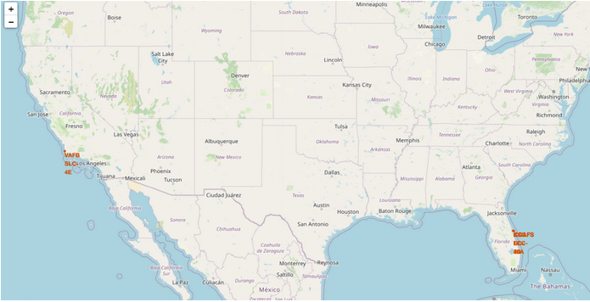
Folium Map Launch Sites

Slide 36
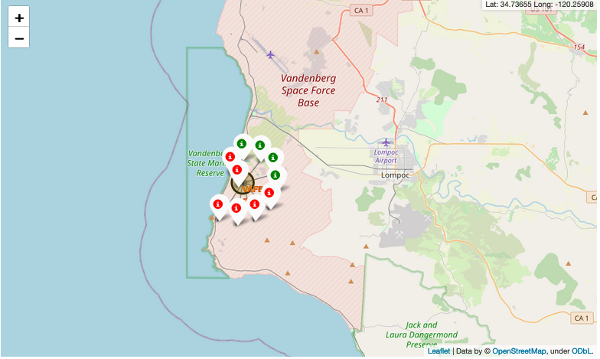
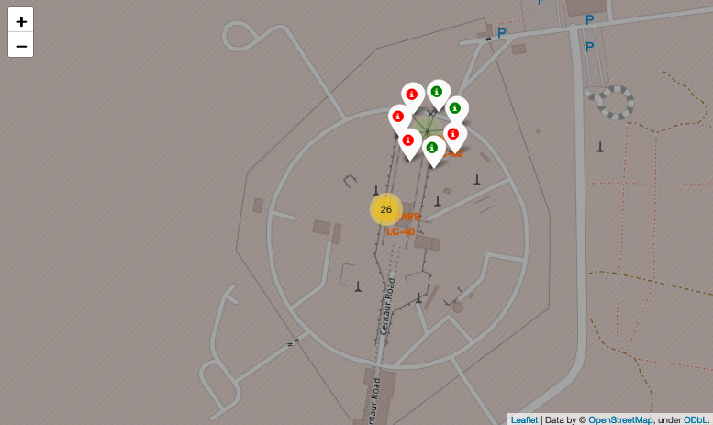
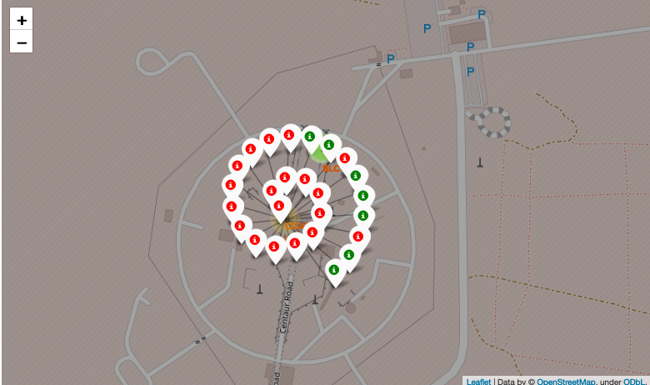
Markers Launch Sites
Green markers = Successful landing, Red marker = Fail landing

Slide 37
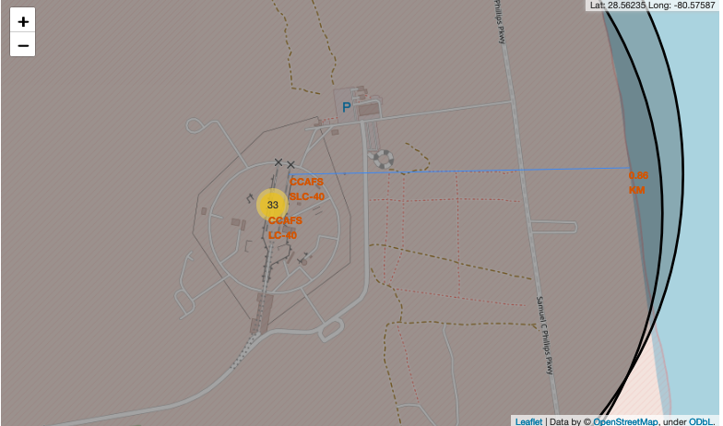
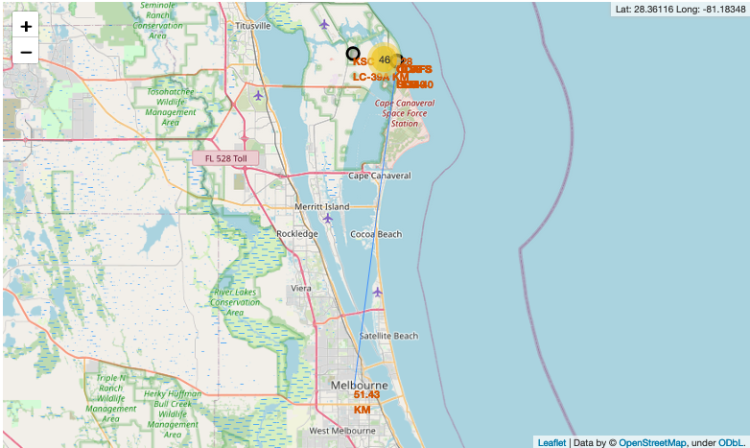
Launch Site distance to landmarks
Is only close to the coast line and the cities.

Slide 38

Section 4

Slide 39
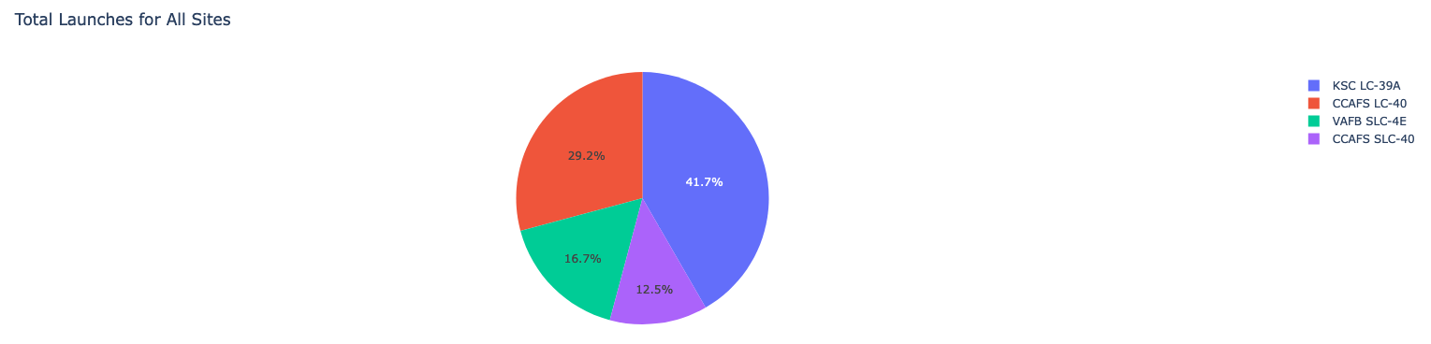
percentage of all successful launches by launch location.
KSC LC -39A has the must successful launches from all sites.

Slide 40
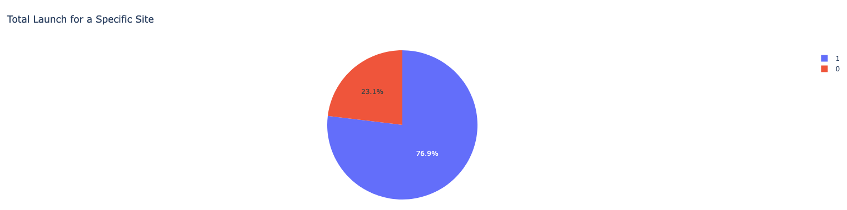
Launch Success Rate
KSC LC-39A shows 76.9% success rate and 23.1% failure rate

Slide 41
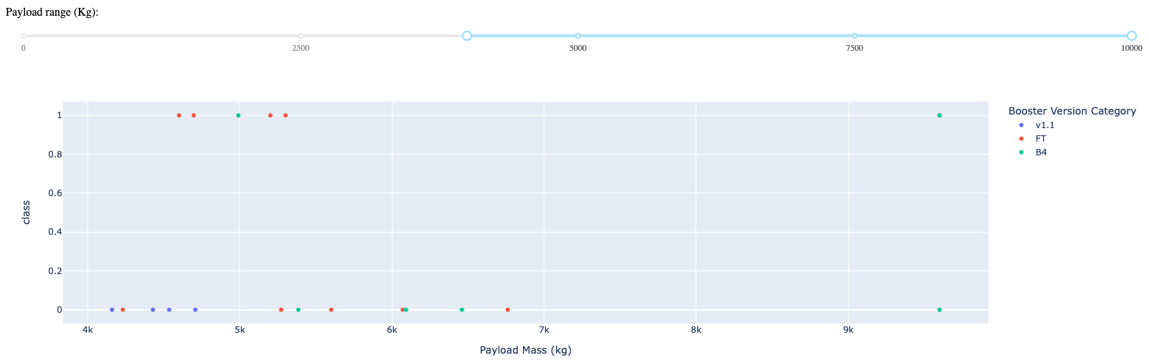
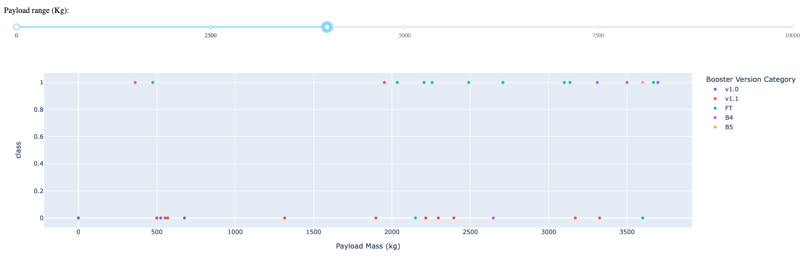
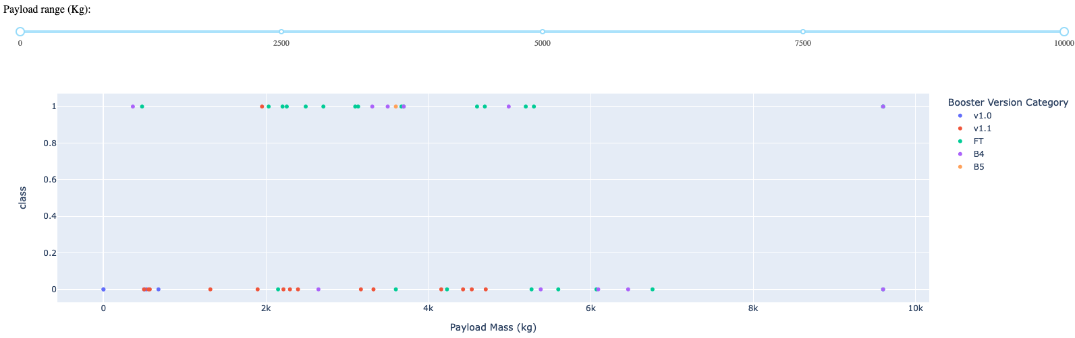
Scatter plot Payload vs Launch Site
the success rate is higher when the payload is lower.

Slide 42

Section 5

Slide 43
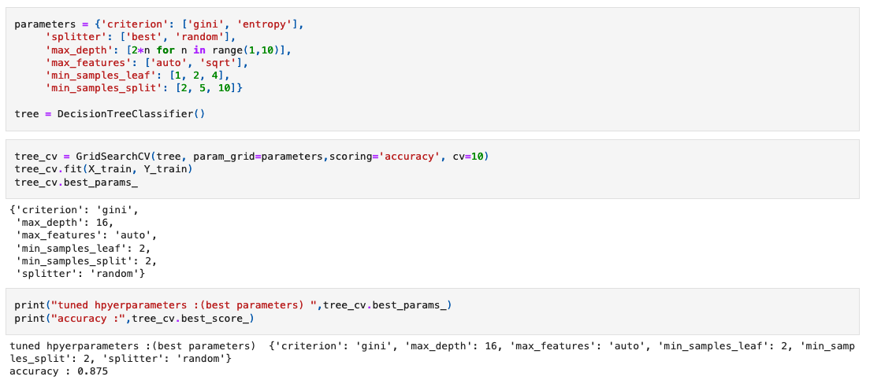
Classification Accuracy
after running different models: logarithmic regression, support machine vector and tree classifier. tree classifier has the best accuracy: 0.875 or 87.5%

Slide 44
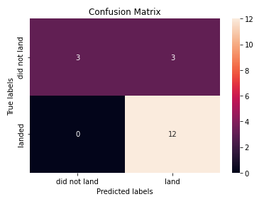
Confusion Matrix
Although the decision tree classifier has the best accuracy, it cannot effectively distinguish between failed and successful landings, so it classifies failed landings as successful.

Slide 45
Conclusions
Launch success rate started to increase in 2013 till 2020.
Orbits ES-L1, GEO, HEO, SSO, VLEO had the most success rate.
KSC LC-39A had the most successful launches of any sites.
The Decision tree classifier is the best machine learning algorithm for this task.

Slide 46
Appendix
https://github.com/pabvel/Coursera_Capstone
https://github.com/pabvel/Coursera_Capstone/blob/main/Dash_SpaceX.py
https://github.com/pabvel/Coursera_Capstone/blob/main/lab_jupyter_launch_site_location(Solve).ipynb
https://github.com/pabvel/Coursera_Capstone/blob/main/dataset_part_1.csv
https://github.com/pabvel/Coursera_Capstone/blob/main/dataset_part_2.csv
https://github.com/pabvel/Coursera_Capstone/blob/main/dataset_part_3.csv

Slide 47


